Slide 1

BUSINESS COMMUNICATIONS 500
TOPIC: ONE
Communication Foundations
Welcome TO Richfield
HYBRID learning

Slide 2
MODULE AIMS AND OUTLINES
Communication is neither the transmission of a message nor the message itself. It is the mutual exchange of understanding, originating with the receiver. Communication needs to be effective in business. Communication is the essence of management. The basic functions of management (Planning, Organizing, Staffing, Directing and Controlling) cannot be performed well without effective communication.
Business communication involves constant flow of information. Feedback is integral part of business communication. Organizations these days are very large and involve large number of people. There are various levels of hierarchy in an organization. Greater the number of levels, the more difficult is the job of managing the organization.
MODULE DETAILS
NQF Level: 5
Credits: 10
Mode of Delivery: Contact/ Distance

Slide 3
PRESCRIBED AND RECOMMENDED MATERIAL
PRESCRIBED MATERIAL
Mary Ellen Guffey ,Dana Loewy © 2018, 2015 Cengage, Business Communication: Process & Product, 9th Edition
RECOMMENDED MATERIAL
Mary Ellen Guffey ,Dana Loewy © 2018, 2015 Cengage, Business Communication: Process & Product, 9th Edition
E-LEARNING MATERIAL
SPRINGER
EMERALD
E-BOOKS
RESEARCHGATE
CENGAGE

Slide 4
Learning Objectives
In this chapter, you will learn about:
Explain how communication skills fuel career success and understand why writing skills are vital in a digital, mobile, and social-media-driven workplace.
Discuss effective practices and technologies for planning and participating in face-to-face meetings and virtual meetings.
Understand the powerful effects of globalization and the major trends fueling it.
Define culture, name its primary characteristics, and explain the five key dimensions of culture: context, individualism, time orientation, power distance, and communication style.

Slide 5
Introduction
Business Communication is goal oriented. The rules, regulations and policies of a company have to be communicated to people within and outside the organization.
Business Communication is regulated by certain rules and norms. In early times, business communication was limited to paper-work, telephone calls etc.
But now with advent of technology, we have cell phones, video conferencing, emails, satellite communication to support business communication. Effective business communication helps in building goodwill of an organization.
The importance of communication in an organization is to promote motivation by informing and clarifying the employees about the task to be done, the manner they are performing the task, and how to improve their performance if it is not up to the mark.

Slide 6
Trends and Challenges in the Information Age Workplace
Although interacting with others on Facebook, YouTube, Instagram, WhatsApp, FaceTime, or Twitter may seem a daily necessity to you, social media are still relatively new and untried communication channels for some small businesses. Larger organizations, however, are completely plugged in and have created a positive presence with the help of both traditional and social media.
Quite logically, social media networks first attracted industries built on communication and technology, such as mainstream media outlets and information technology firms. New communication technologies also quickly took hold among marketers, in public relations, and in advertising. Even so, many businesses relying on traditional media seem to be waiting to figure out how the new media might benefit them to justify the investments.

Slide 7
Ethics in the Workplace Needed More Than Ever
Ethics refers to conventional standards of right and wrong that prescribe what people should do. These standards usually consist of rights, obligations, and benefits to society. They also include virtues such as fairness, honesty, loyalty, and concern for others. Ethics is about having values and taking responsibility. Ethical individuals follow the law and refrain from theft, murder, assault, slander, and fraud.

Slide 8
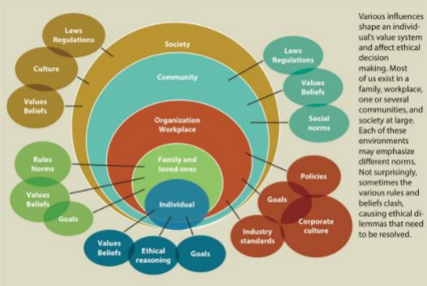
The Context of Ethical Decision Making

Slide 9
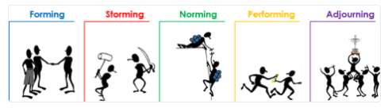
Understanding the Four Phases of Team Development
Tuckman's model explains that as the team develops maturity and ability, relationships establish, and leadership style changes to more collaborative or shared leadership.

Slide 10
Four Phases of Team Development
Forming: Marketing is a collaborative task that requires different people with different expertise. There’s also a ton of background context in marketing—previous campaigns, style guides, brand guides, and more.
Storming: Disagreements are unavoidable on teams, especially when each person on the team has a different perspective on how to approach the issues the team encounters. When you all work in the same location, it can be easier to hash out problems quickly.

Slide 11
Four Phases of Team Development conti’
Norming: When teams work in the same space, it’s easy to see what everyone’s doing. Designers are talking to product managers to get direction, or product managers meet with analysts to talk about user data and reports
Performing: There’s a high level of cohesion and trust between team members. Teams are functioning at peak efficiency with less oversight from team leaders. Issues still come up, but at this point, teams have strategies for resolving problems without compromising timelines and progress.

Slide 12
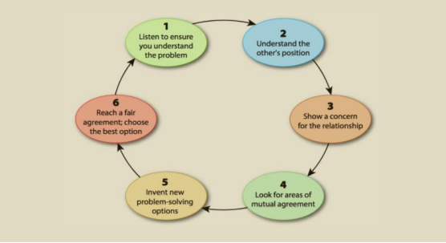
Six Steps for Dealing with Conflict

Slide 13
Planning and participating in face-to- face and virtual meetings
Determining the Purpose of a Meeting A face-to-face meeting provides the most nonverbal cues and other signals that help us interpret the intended meaning of words. Thus, an in-person meeting is the richest of available media. No meeting should be called unless it is important, can’t wait, and requires an exchange of ideas.
Selecting Meeting Participants.
Using Digital Calendars to Schedule Meetings.
Distributing an Agenda and Other Information
Managing the Meeting

Slide 14
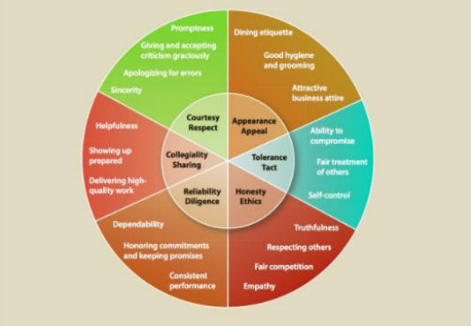
The Six Dimensions of Professional Behaviour

Slide 15
Becoming interculturally proficient
Remember that culture is learned. Developing cultural competence often involves changing attitudes. Through exposure to other cultures and through training, such as you are receiving in this course, you can learn new attitudes and behaviors that help bridge gaps between cultures.
Following are some suggestions to help you boost your intercultural savvy.
Building Cultural Self-Awareness.
Understanding Generalizations and Stereotyping.
Being Open-Minded.
Saving Face.

Slide 16
Culture and ethical business practices
Today most companies that are active in global markets have ethical codes of conduct. These codes are public documents and can usually be found on company websites. They are an accepted part of governance.
The growing sophistication of these codes results in ethics training programs that often include complicated hypothetical questions. Ethics trainers teach employees to solve problems by reconciling legal requirements, company policies, and conflicting cultural norms.

Slide 17
Workforce Diversity: Benefits and challenges
Workplace diversity is currently a very hot topic among businesses. The modern workplace considers workplace diversity a crucial element of success and happiness in the office and are advocates for social improvements.
Building a diverse workforce can be a challenge for some businesses, but there are solutions to create a sense of harmony and unity among different people and teams.
Benefits: Increased innovation, Enhanced productivity & Improved company culture.
Challenges: Communication issues & Resistance to change.

Slide 18
THANK YOU
REVIEW QUESTIONS PG 32

